Slide 1
Agenda
Azure Repos
Azure Repo
Team Foundation Version Control
Git
Git vs. GitHub
Git Workflow
Git Commands
Git Branching
Git Merging

Slide 2
Azure Repos
Repo is used to manage and track your code and its changes while working with a team.
Azure DevOps offers two Repos models of version control: Git and TFVC (Team Foundation Version Control)
Azure repos supports IDE like Visual Studio, VS Code, Xcode, Eclipse, Command-line and IntelliJ etc.
Supports code import of an existing repo from GitHub, Bitbucket and GitLab.

Slide 3
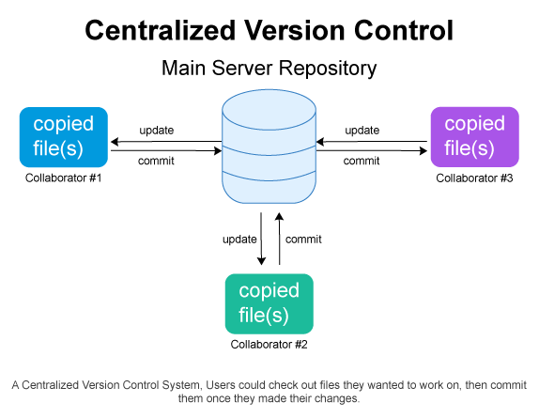
TFVC: Team Foundation Version Control
A Centralized Version Control system provided by Azure DevOps to manage your code and files and track changes you make in your code over time.

Slide 4
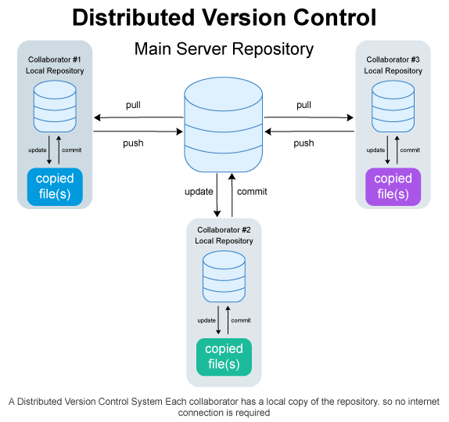
Git
Git is an Open-source Distributed Version Control system that is designed to manage project version control speedy and effectively.
Notes:
Centralized version control system you always need connection with the server so remote commits are very slow, in Distributed version control we have local repos so commits are fast and no active connection needed with the server all the time.
So, compete to TFVC, Git is very advanced and with rich features.

Slide 5
Git vs GitHub
A free and open-source version control system to manage code
A command line tool
Creates a local repository to track changes locally instead of storing them on a server
No user management
A cloud based service based on git to manage code
Offers GUI interface
Repository is created on cloud to store code in a centralized location
Built-in user management

Slide 6
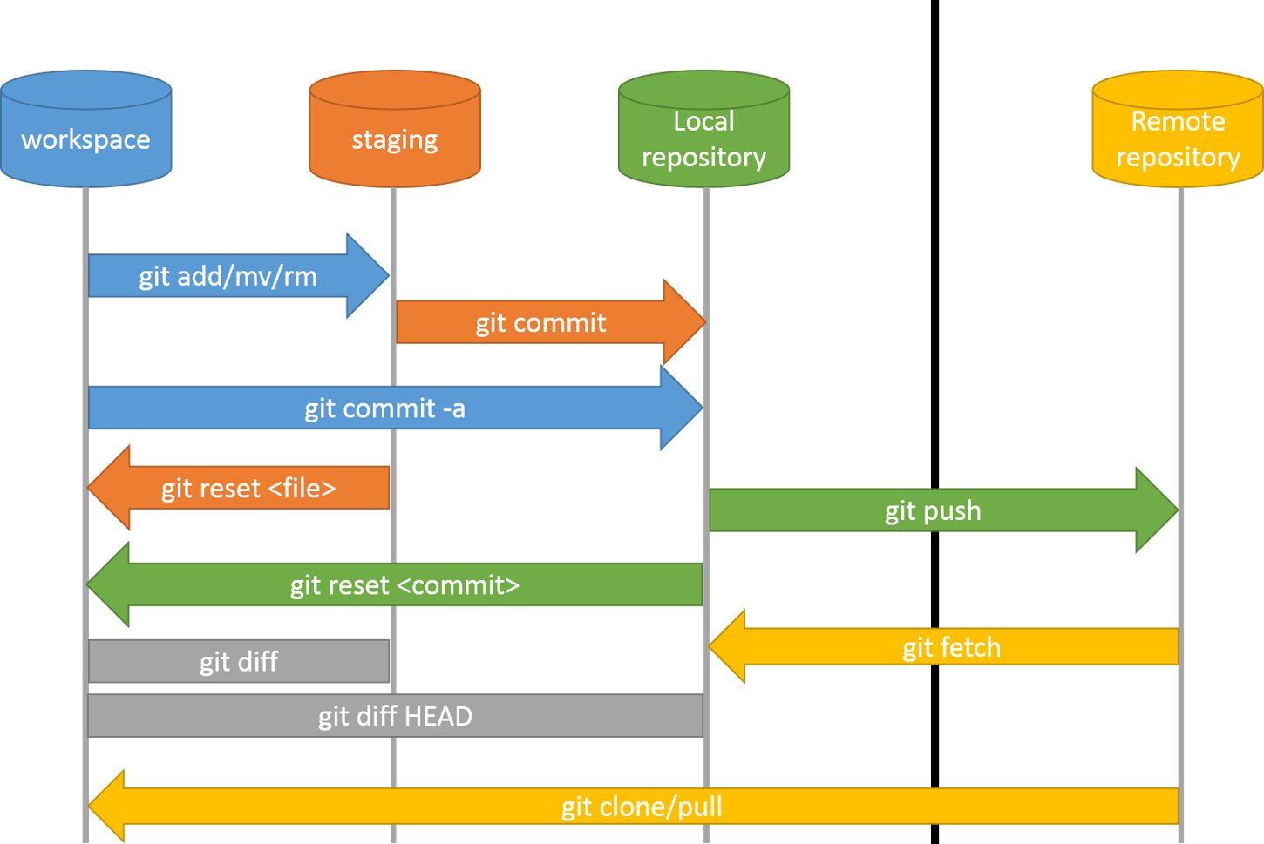
Git Work Flow
Notes:
https://confluence.atlassian.com/bitbucketserver/basic-git-commands-776639767.html
"Push" is you forcing the changes being present in the target repository (git push).
"Pull" is the target repository grabbing your changes to be present there (git pull from the other repo).
A "pull request" is you requesting the target repository to please grab your changes.
A "push request" would be the target repository requesting you to push your changes.
What is the difference between git diff HEAD vs. git diff --staged? - Stack Overflow
git diff View difference between Stage and Working Directory
git diff --staged View difference between HEAD and Stage
git diff HEAD View difference between HEAD and Working Directory
HEAD means (the reference to the) current commit
HEAD~1 means (the reference to) 1 commit before
HEAD~ ALSO means (the reference to) 1 commit before
HEAD~87 means (the reference to) 87 commits before
HEAD~3..HEAD means from 3 commits to current commit
git log

Slide 7
Git Global Configuration
git config --global user.name "Shailendra Chauhan"
git config --global user.email pro.shailendra@gmail.com
git config --global --list

Slide 8
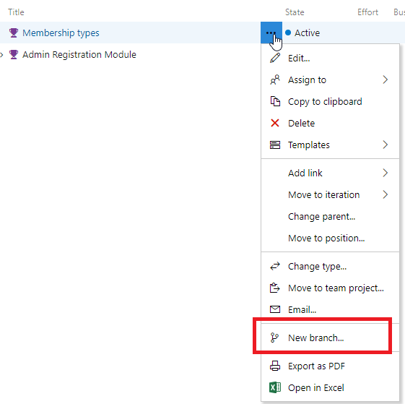
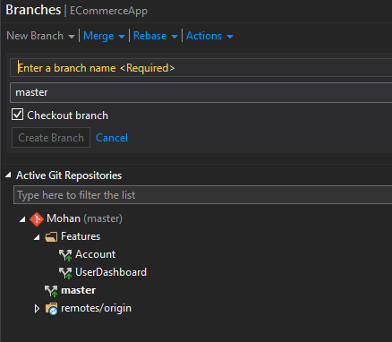
Create A Feature Branch

Slide 9
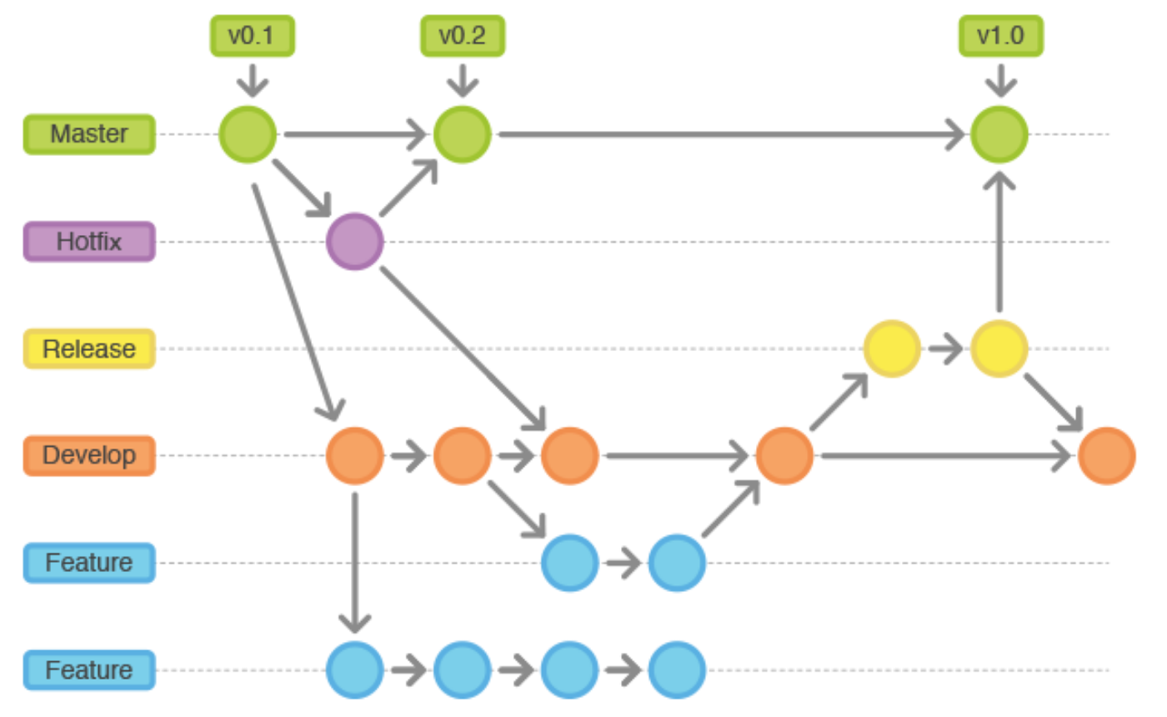
Branches: Master, Develop, Feature, Release
Notes:
Master branch
Reserved for stable releases (alpha, beta, etc.) with all relevant features completed
Commits should never be made directly to master - new versions are created by merging from develop
Develop branch
Reflects stable versions with all new features included as they are completed.
Commits should never be made directly to develop - changes should be merged from feature branches.
Feature branches
For working on a new feature/bugfix in isolation from the develop branch
New feature branches should be based on develop, not master
Naming convention is feature/some-cool-new-feature
Release branch
Once develop has acquired enough features for a release (or a predetermined release date is approaching), you fork a release branch off of develop. Creating this branch starts the next release cycle, so no new features can be added after this point.Only bug fixes, documentation generation, and other release-oriented tasks should go in this branch(which includes testing also). Once it's ready to ship, the release gets merged into master and tagged with a version number.

Slide 10
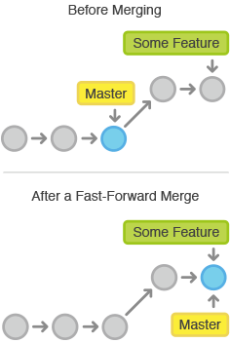
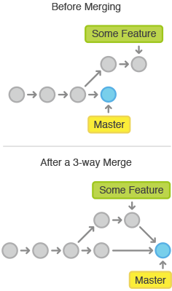
Merging: Fast-Forward & 3-Way Merge
Notes:
A fast-forward merges are used to fix bugs and small features.
3-way merges are used to integrate long-running features.
Rebase is a fast-forward merge, that means the pointer would include all the previous commits of the pointer you are rebasing from and add your own commits after. Rebase keeps your tree clean and straight.

Slide 11
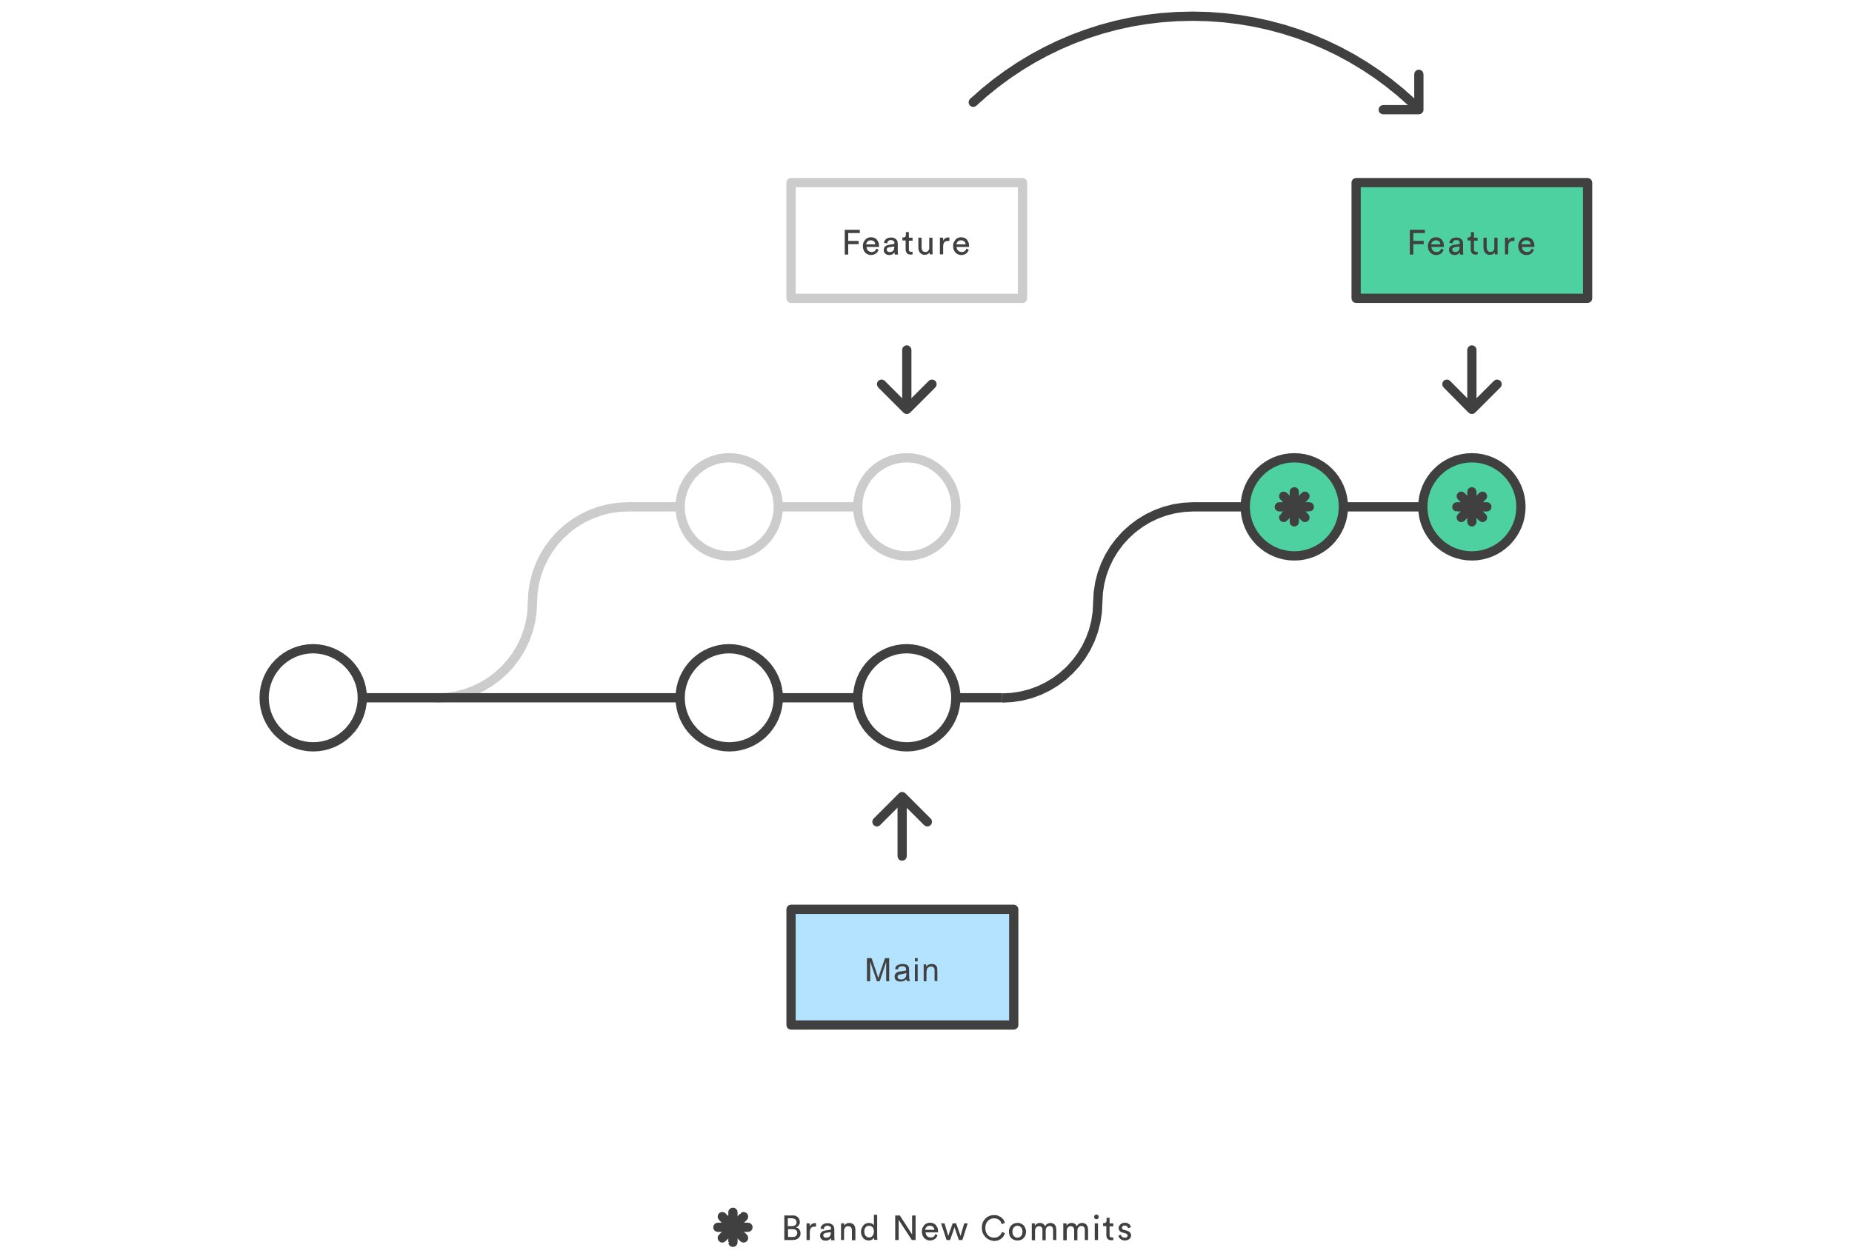
Git Rebase
Rebasing is changing the base of your branch from one commit to another.
The primary reason for rebasing is to maintain a linear project history.
For example, the main branch has progressed since you started working on a feature branch. You want to get the latest updates to the main branch in your feature branch, but you want to keep your branch's history clean, so it appears as if you've been working off the latest main branch.
Notes:
The primary reason for rebasing is to maintain a linear project history. For example, consider a situation where the main branch has progressed since you started working on a feature branch. You want to get the latest updates to the main branch in your feature branch, but you want to keep your branch's history clean so it appears as if you've been working off the latest main branch.
git rebase | Atlassian Git Tutorial

Slide 12
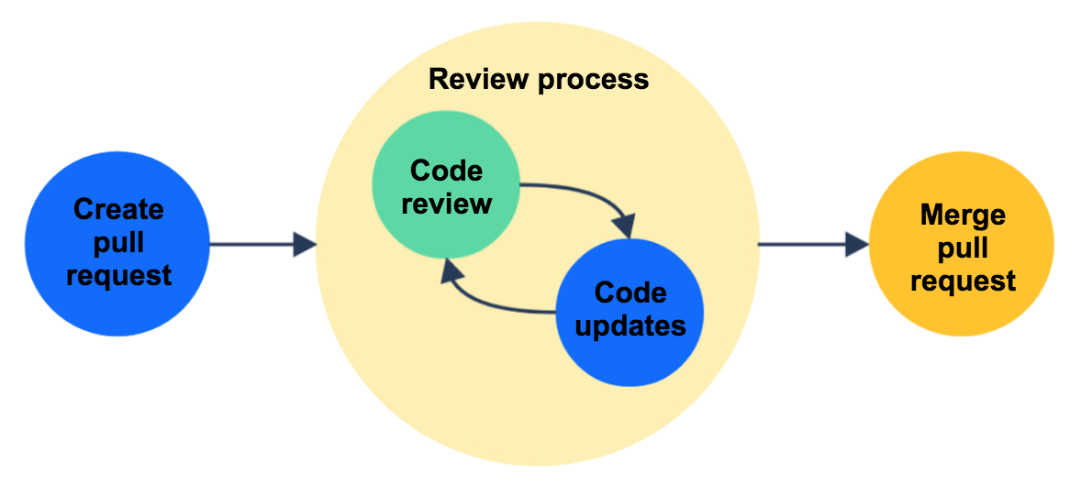
Merge Pull Request
Notes:
Master branch
Reserved for stable releases (alpha, beta, etc.) with all relevant features completed
Commits should never be made directly to master - new versions are created by merging from develop
Develop branch
Reflects stable versions with all new features included as they are completed.
Commits should never be made directly to develop - changes should be merged from feature branches.
Feature branches
For working on a new feature/bugfix in isolation from the develop branch
New feature branches should be based on develop, not master
Naming convention is feature/some-cool-new-feature
Release branch
Once develop has acquired enough features for a release (or a predetermined release date is approaching), you fork a release branch off of develop. Creating this branch starts the next release cycle, so no new features can be added after this point.Only bug fixes, documentation generation, and other release-oriented tasks should go in this branch(which includes testing also). Once it's ready to ship, the release gets merged into master and tagged with a version number.

